Slide 1
Using AI to Measure Parkinson’s Disease Severity at Home
NATURE DIGITAL MEDICINE JOURNAL
AUTHORS:
Md Saiful Islam 1,2✉, Wasifur Rahman1 , Abdelrahman Abdelkader1 , Sangwu Lee 1 , Phillip T. Yang3 , Jennifer Lynn Purks3 , Jamie Lynn Adams3 , Ruth B. Schneider 3 , Earl Ray Dorsey 3 and Ehsan Hoque
Presented To: Dr Shehzad
Course: Data science Tools and Techniques
Presented By: Javeria Hassan (23K-8019)

Slide 2
Presentation Breakdown
The Presentation is breakdown in the following sections:
Abstract
Introduction
Dataset Overview
Data Processing
Demographic Information
Model Performance
Our Model Performance
Data Availability
Conclusion

Slide 3
Abstract
We introduce an AI system for remote assessment of motor performance in Parkinson's disease. 250 participants globally underwent finger-tapping tasks rated by expert neurologists. Our algorithms aligned with the Movement Disorder Society Unified Parkinson’s Disease Rating Scale (MDS-UPDRS) and demonstrated excellent inter-rater reliability (ICC 0.88). The machine learning model, trained on these measures, outperformed certified raters, showcasing a mean absolute error (MAE) of 0.58 compared to their average MAE of 0.83. While slightly trailing expert neurologists (0.53 MAE), this methodology offers replicability for similar motor tasks, enabling efficient evaluations.

Slide 4
Introduction
PD, a non-curable, fast-growing neurological disease, faces limited access to neurological care globally, particularly in underdeveloped regions. The finger-tapping task, assessing bradykinesia, a key PD symptom, is crucial but hindered by limited clinical visits. Our AI-driven solution envisions a global, automated assessment of motor performance severity through a webcam-based finger-tapping task. Overcoming challenges of data collection in diverse environments, we derive clinically relevant features, highly correlating with expert ratings. An interpretable AI model, trained on these features, rivals expert clinicians in assessing severity, potentially enhancing PD care accessibility worldwide.

Slide 5
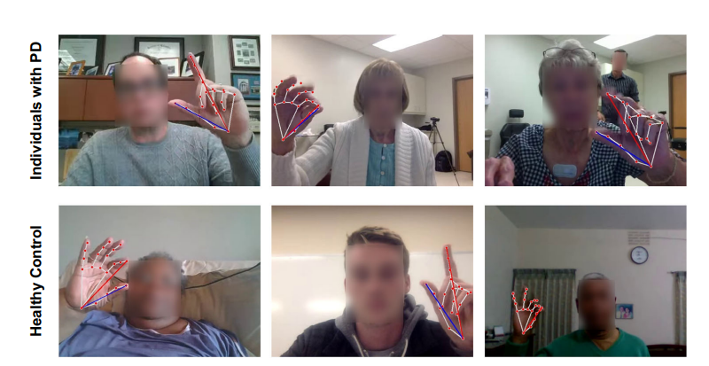
Data Collection

Slide 6
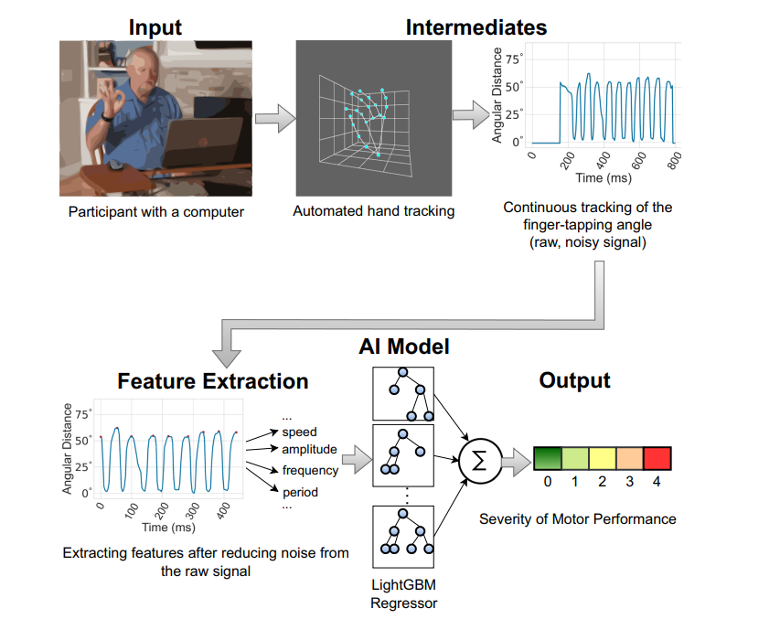
Data Processing

Slide 7
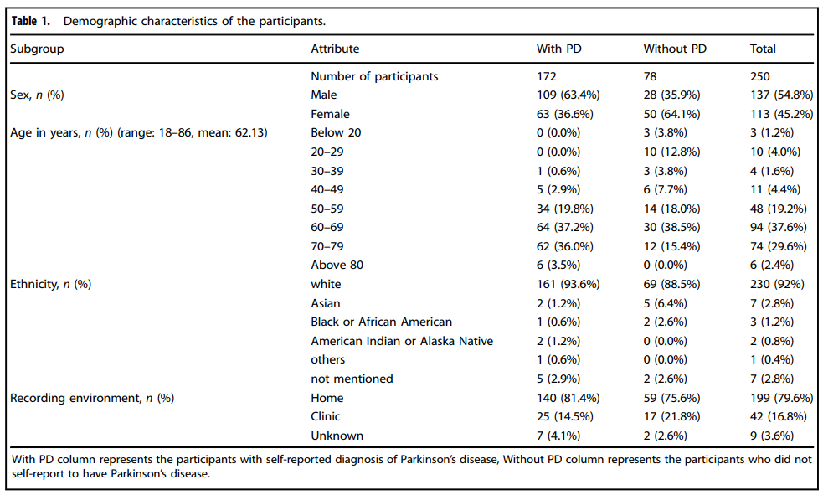
Demographic Analysis

Slide 8
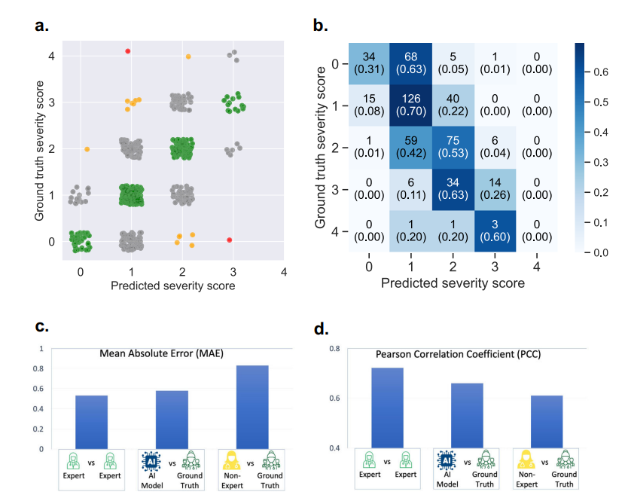
Model Performance

Slide 9
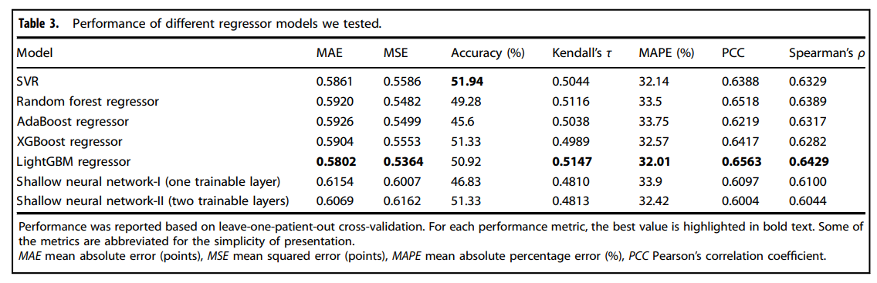
Model Performance

Slide 10
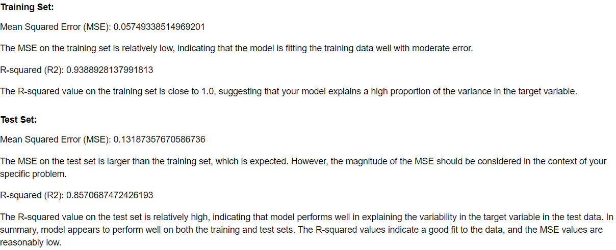
Our Model Analysis

Slide 11
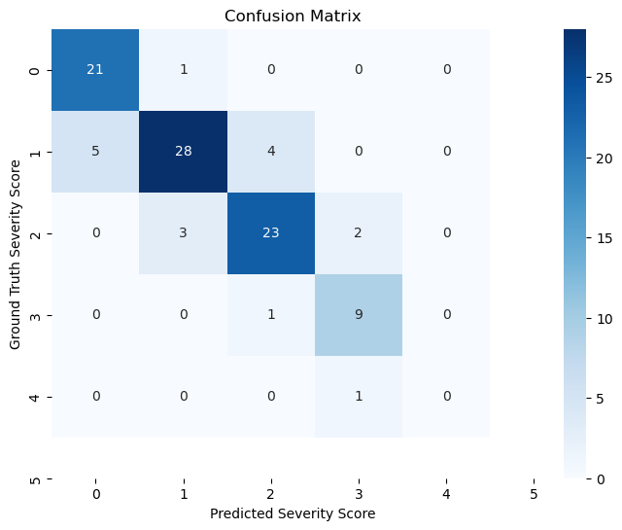
Our Model Analysis

Slide 12
Data Availability
The recorded videos were collected using a web-based tool. The tool is publicly accessible at https://parktest.net. Unfortunately, we are unable to share the raw videos due to the Health Insurance Portability and Accountability Act (HIPAA) compliance. However, the extracted features and clinical ratings are publicly available: https://github.com/ROC-HCI/finger-tapping-severity. The features are provided in a structured format that can be easily integrated with existing machinelearning workflows.

Slide 13
Conclusion
In conclusion, we rigorously evaluated various regressor models for motor performance assessment in Parkinson's disease using comprehensive performance metrics. The results from leave-one-patient-out cross-validation highlight the LightGBM regressor as the most effective model, achieving the lowest mean absolute error (MAE) of 0.5802 and outperforming other models in multiple metrics, including accuracy, Kendall's τ, MAPE, PCC, and Spearman's ρ. This robust evaluation provides valuable insights into the effectiveness of different regressors, paving the way for enhanced accuracy and reliability in assessing Parkinsonian symptoms through AI-driven methodologies.

Slide 14
References
1. Willis, A., Schootman, M., Evanoff, B., Perlmutter, J. & Racette, B. Neurologist care in Parkinson disease: a utilization, outcomes, and survival study. Neurology 77, 851–857 (2011). 2. Kissani, N. et al. Why does Africa have the lowest number of neurologists and how to cover the gap? J. Neurol. Sci. 434, 120119 (2022).
3. Hughes, A. J., Daniel, S. E., Kilford, L. & Lees, A. J. Accuracy of clinical diagnosis of idiopathic Parkinson’s disease: a clinico-pathological study of 100 cases. J. Neurol. Neurosurg. Psychiatry 55, 181–184 (1992).
4. Khan, T., Nyholm, D., Westin, J. & Dougherty, M. A computer vision framework for finger-tapping evaluation in Parkinson’s disease. Artif. Intell. Med. 60, 27–40 (2014).
5. Williams, S. et al. Supervised classification of bradykinesia in Parkinson’s disease from smartphone videos. Artif. Intell. Med. 110, 101966 (2020).
6. Nunes, A. S. et al. Automatic classification and severity estimation of ataxia from finger tapping videos. Front. Neurol. 12, 2587 (2022).
7. Quinonero-Candela, J., Sugiyama, M., Schwaighofer, A. & Lawrence, N.D. Dataset Shift in Machine Learning, Vol. 1, 5 (MIT Press, 2008)

